Slide 1
Gene therapy

Slide 2
Lecture Plan
Molecular Medicine and Gene Therapy: An Introduction
Vectors in Gene Therapy
Viral vector of gene therapy
Non viral vector of gene therapy
Gene Targeting
Cancer genes and the pathways they control
The Genetic Basis of Cancer
Gene therapy progress and prospects cancer
Tumor Suppressor Gene Replacement for Cancer
Antisense Technology
Receptor directed molecular conjugates for gene transfer
Conditional gene targeting for cancer gene therapy
Pharmacogenetics of breast cancer therapies
Hypoxia targeting gene expression for breast cancer gene therapy
Gene expression proﬁling: Decoding breast cancer
Ethical issues in Molecular Medicine and Gene Therapy
Epilogue: Personal Genetic Medicine—The Future Is Now
Term paper: Commercial Implications of gene therapy
Notes:
Gene Therapy in the Treatment of Cancer

Slide 3
Molecular Medicine and Gene Therapy
Segment: 1
Gene Therapy

Slide 4
Here are some things you'll want to think about.
If you want to develop a cure for a disease by gene therapy, here are some things to think about:
How will you reach the target cells and deliver the gene?
ex vivo vs. in vivo
What proportion of target cells need to be altered?
Does the gene need to be expressed constitutively, or regulated?
Would there be serious consequences if the gene were overexpressed?
How long will the DNA persist and be expressed?
If you are planning to modulate gene expression, how will you do it (e.g. ribozymes, antisense, short interfering RNAs ! siRNA)?

Slide 5
Some Diseases

Slide 6
Ref: An introduction to molecular medicine and gene therapy 2001

Slide 7
Ref: An introduction to molecular medicine and gene therapy 2001

Slide 8
P -
Point mutation, or any insertion/deletion entirely inside one gene
D -
Deletion of a gene or genes
C –
Whole chromosome extra, missing, or both - see chromosomal aberrations
T –
Trinucleotide repeat disorders - gene is extended in length
www.wikipedia.com

Slide 9
Monogenetic
Disorder
Ref: An introduction to molecular medicine and gene therapy 2001

Slide 10
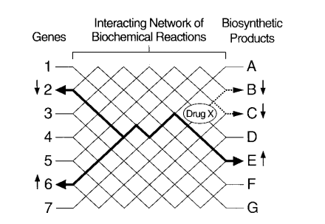
Schematic representation of a system in which genotype and phenotype
Are related by a complex network of interaction involving many proteins,
RNA and reactants
Ref: An introduction to molecular medicine and gene therapy 2001

Slide 11
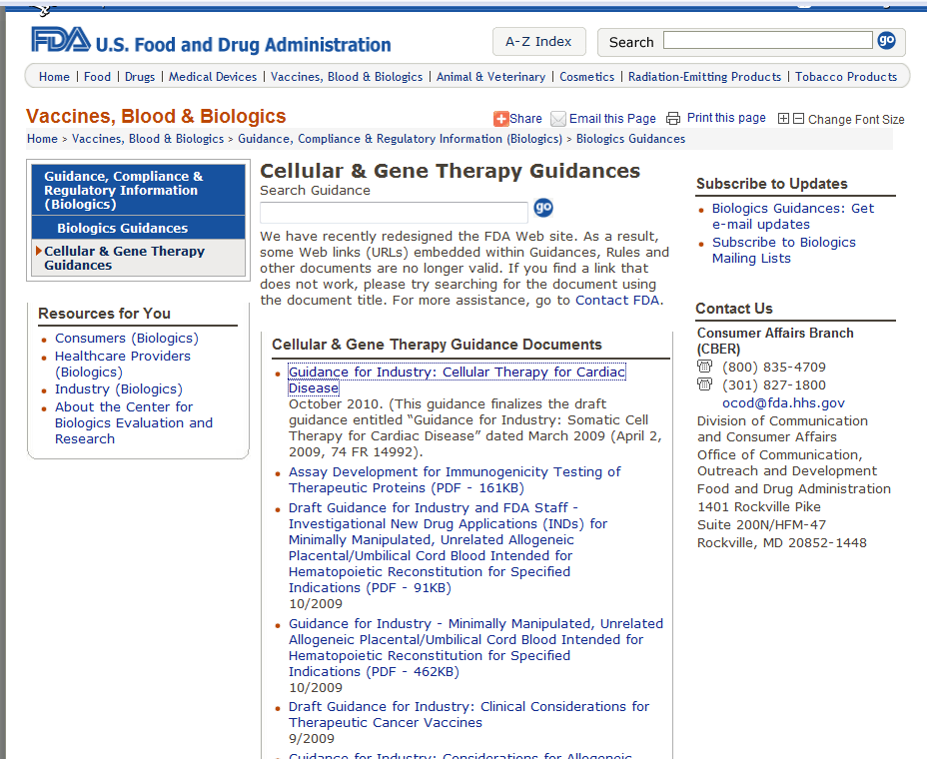

Slide 12
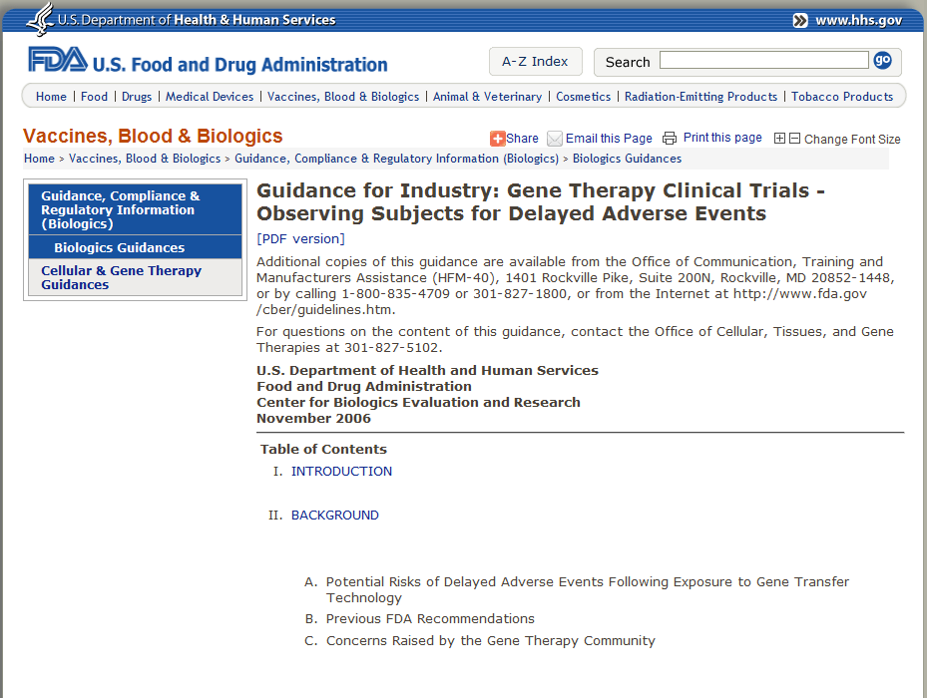

Slide 13
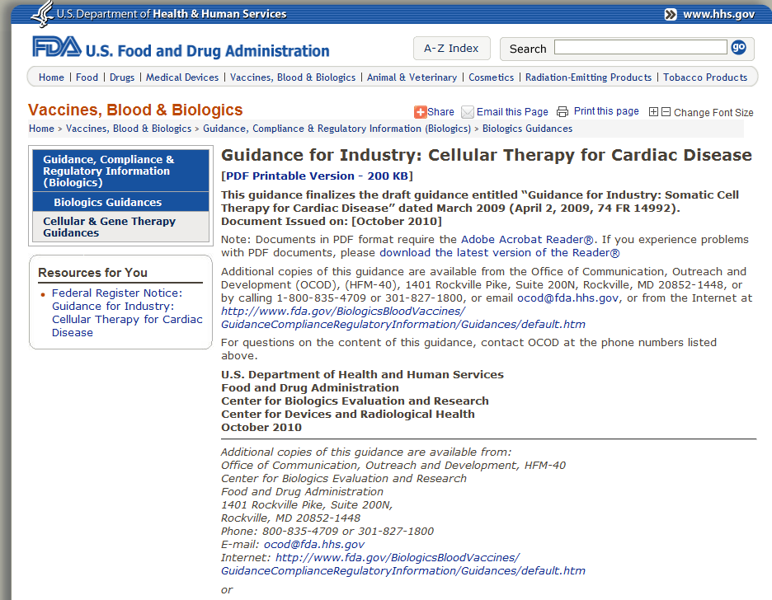

Slide 14
Co-up-regulation and co-down-regulation
Ref: An introduction to molecular medicine and gene therapy 2001

Slide 15
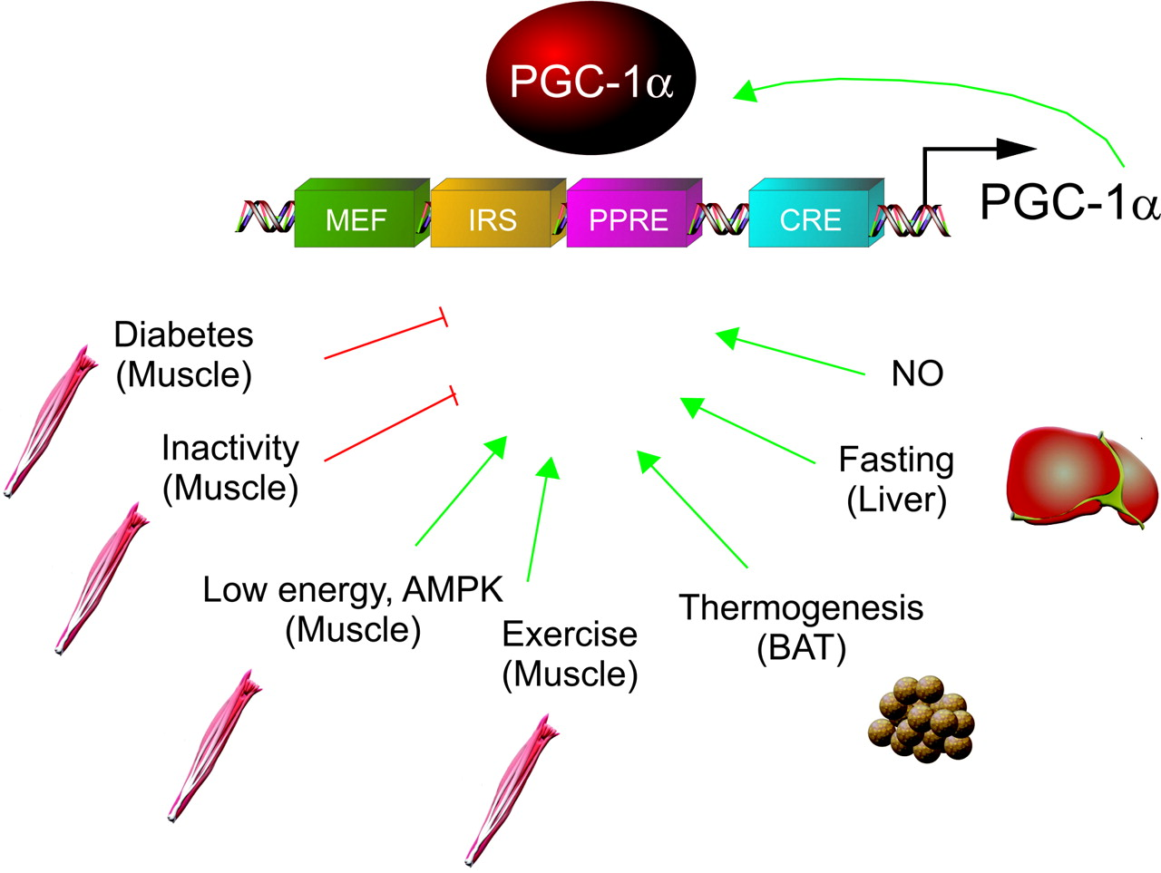
FIG. 1. Regulation of PGC-1{alpha} transcription
Handschin, C. et al. Endocr Rev 2006;27:728-735

Slide 16
ACE Gene Insertion/deletion polymorphism
The polymorphism of the human angiotensin-converting enzyme (ACE) gene
The presence (insertion, I allele) or the absence (deletion, D allele) of a 287 bp fragment.
Hence, three variants exist: II, ID, and DD.
This polymorphism occurs in an intron, so not coded
But it is an exceptionally strong and consistent marker for ACE activity in Caucasians.
Increasing ACE activity is associated with the D allele,

Slide 17
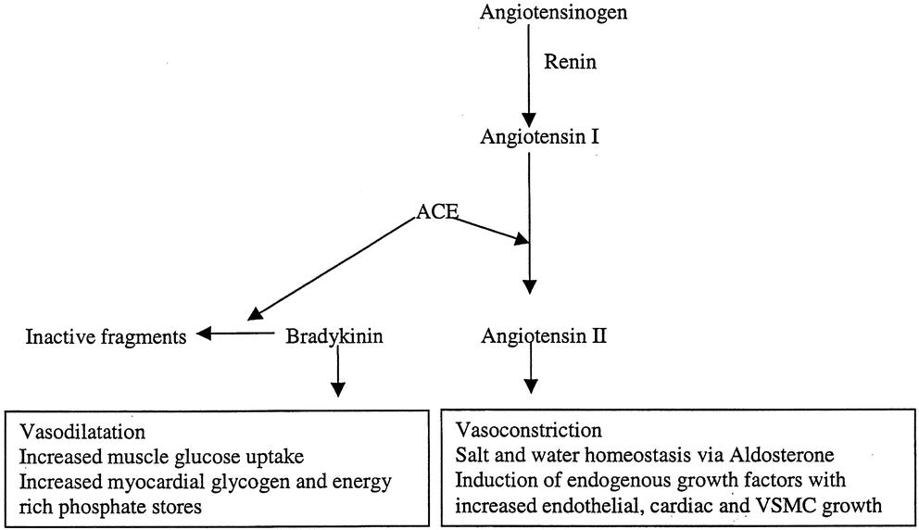
ACE (Angiotensin I converting enzyme) calayses production of angiotensin II and the breakdown of bradykinin

Slide 18
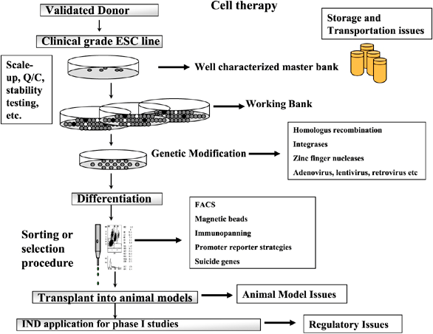
Flow chart of the cell culture and gene targeting process.
http://www.nature.com/gt/journal/v15/n2/fig_tab/3303061f1.html

